Slide 2
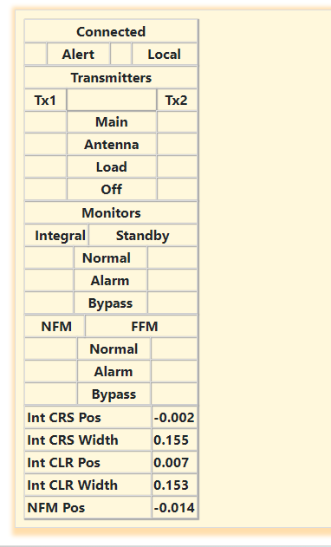
TX1 Data
TX1 (Transmitter1 is On)

Slide 3
TX2 Data
TX2 (Transmitter2 is On)

